Slide 1
Deep Learning in Action
Word2Vec
Reporter：Jackokie Zhao

Slide 2
Introductions
1

Slide 3
What is Word2Vec

Slide 4
算法框架
基于物品的协同过滤生成物品的相似性；
NLP领域应用神经嵌入算法学习词汇的潜在表示（word2vec）
Item-CF在同一个神经元嵌入框架中进行映射
提出item2vec，生成物品在潜在空间的嵌入(Embedding)，
即便用户信息不可用，仍可推断出物品之间的联系
结果表明作者的方法相较于SVD具有一定的优势
1
2
3
4

Slide 5
Backgroud Knowledge
2

Slide 6
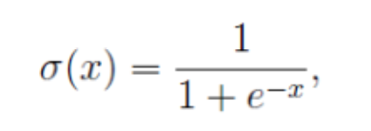
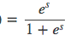
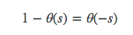
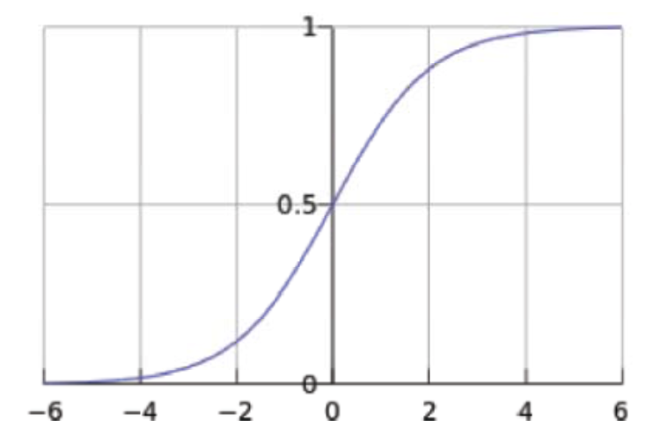
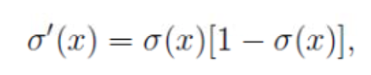
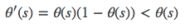
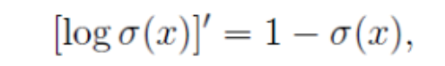
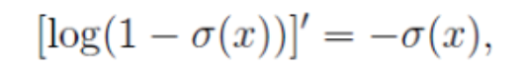
2.1 Sigmoid Function
Properties：

Slide 7
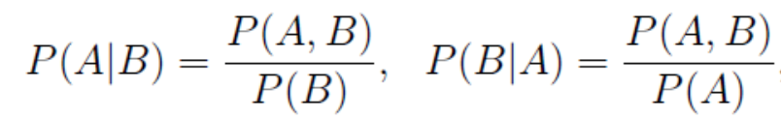
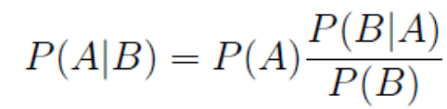
2.2 Bayes

Slide 8
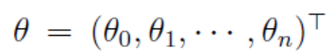
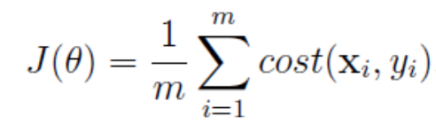
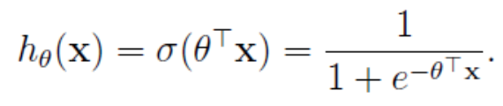
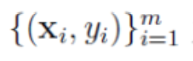
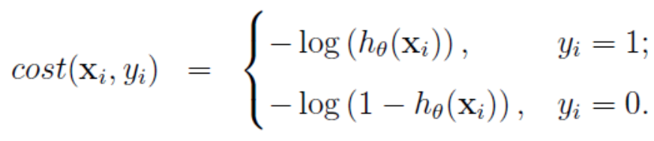
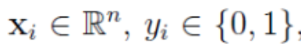
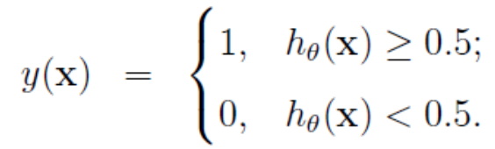
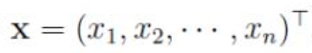
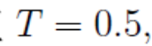
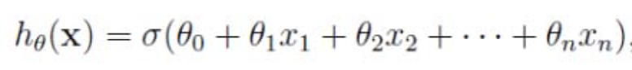
2.2 Logistic Regression
Train Samples
Hysteresis
Cost Function

Slide 9
2.3 Huffman Coding
A. Huffman Tree
<1> Path & Length
<2> Node Weight & Path weighted Length
<4> Binary Tree & Optimal Binary Tree
<3> Length of Tree Path weighted
1. The words with a high frequency
will bubble to the top of the tree.
2. Right Child’s frequency is smaller.
B. Construction of Huffman Tree
<1> Consider {$w_{1}, w_{2},…,w_{n}$} as a Forest(One Node each Tree).
<1> Consider {𝒘_𝟏, 𝒘_𝟐,…,𝒘_𝒏} as a Forest(One Node each Tree).
<2> Merge two tree with min root node weight(new_root = left + right).
<4> Repeat <2> and <3> until there exists only one tree.
<3> Delete the selected trees and put the new tree to forest.

Slide 10
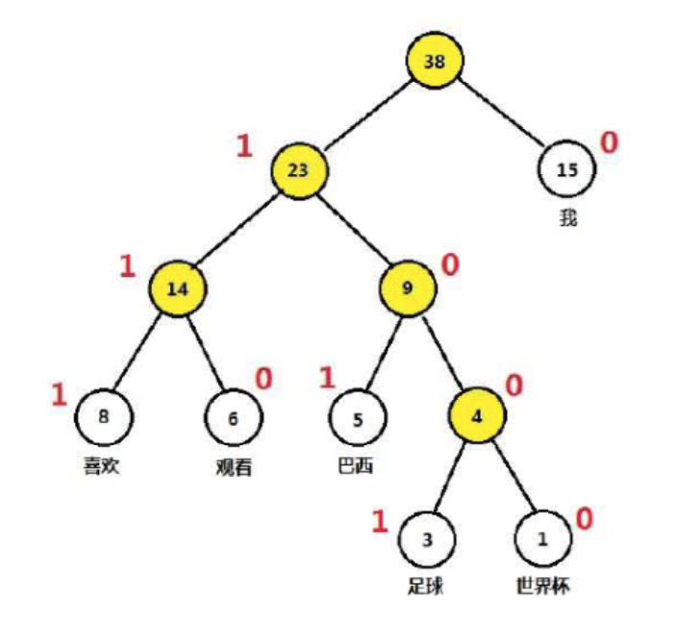
2.3 Huffman Coding
A. Huffman Tree Coding
0
111
110
101
1001
1000
000
001
010
011
100
101
110
111
Fix Length
Variable Lenghth
<0> The min length of Delivery Message.
<1> Node weight is the frequency of leaf appearance.
<2> 1→ Node with a higher weight(Left).
<3> 0→ Node with a lower weight(Right).

Slide 11
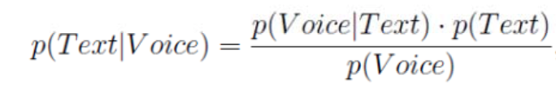
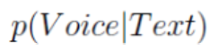
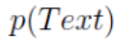
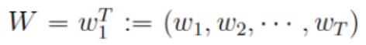
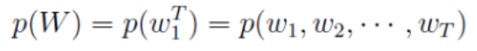

2.4 Statistical Language Model
Voice Recognition System
Acoustic Model
Language Model
Probability Model
Model Parameters
Dictionary Size：N
$${TN}^{T}$$
Sentence Length : T
Sentence Parameters : T

Slide 12
Model
3

Slide 13
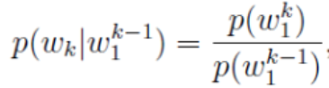
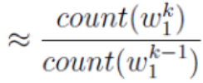
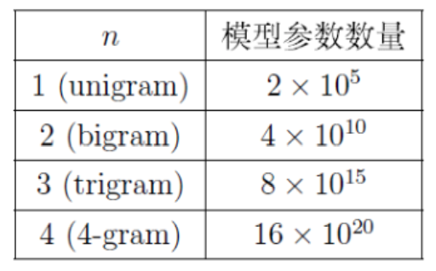
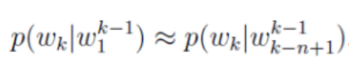
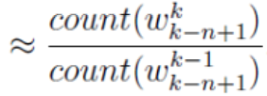
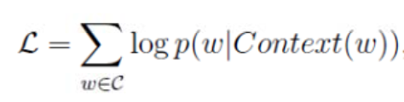
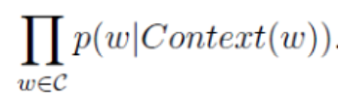

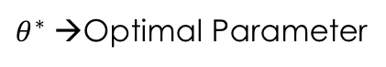
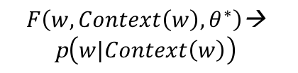
3.1 N-Gram Model
Count the words appearing in the context and make it smooth, and then store the probability value.
$$O\left(N^{n}\right)$$
$θ^{∗}$ →Optimal Parameter
$$F\left(w,Context\left(w\right),θ^{∗}\right)\text{→}$$
$$\text{p}\left(w|Context\left(w\right)\right)$$
Max Likelyhood
Max Log Likelyhood
F Function Constructions

Slide 14
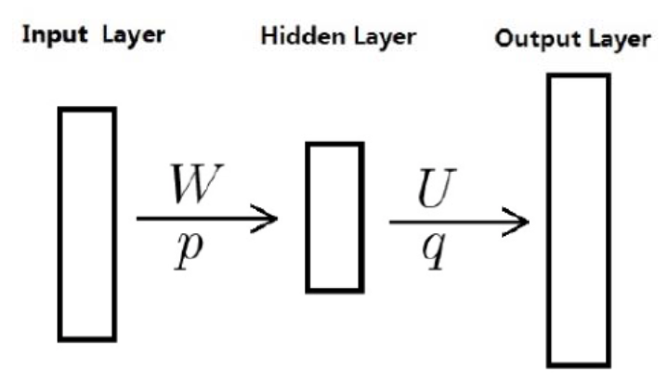
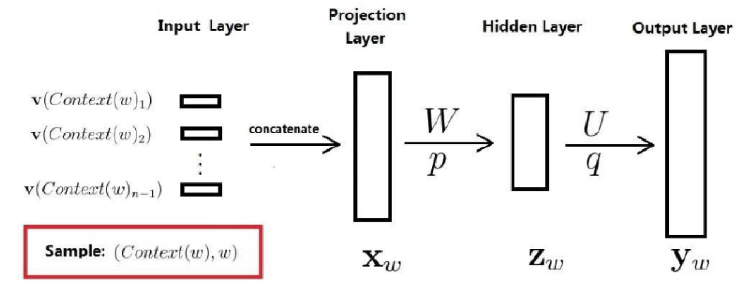
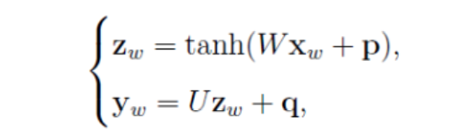
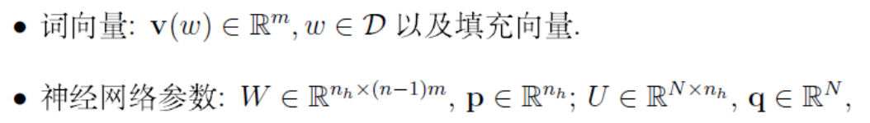
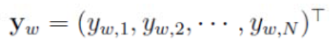
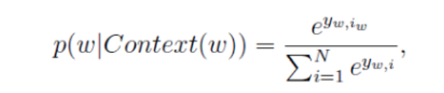
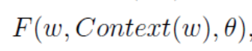
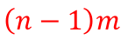
3.2 Neural Probability Language Model
$$\left(n−1\right)m$$
N=|D|
Main Parameters
Projection Layer --- (n-1)*m (n is context, m is word vector length)
Output Layer --- N(Dictionary Size)
Hidden Layer --- temp(User Define)
Softmax Layer --- Full Connected
Advantages to n-gram
Words Similarity == Word Vectors’ Distance
Smooth by itself
Notes:
在投影层和输出层神经元之间相连情况下，会多出一个权值矩阵，此处忽略这种情况。在实际情况中，引入这个矩阵并不能提高模型效果，但是可以减少训练的迭代次数。

Slide 15
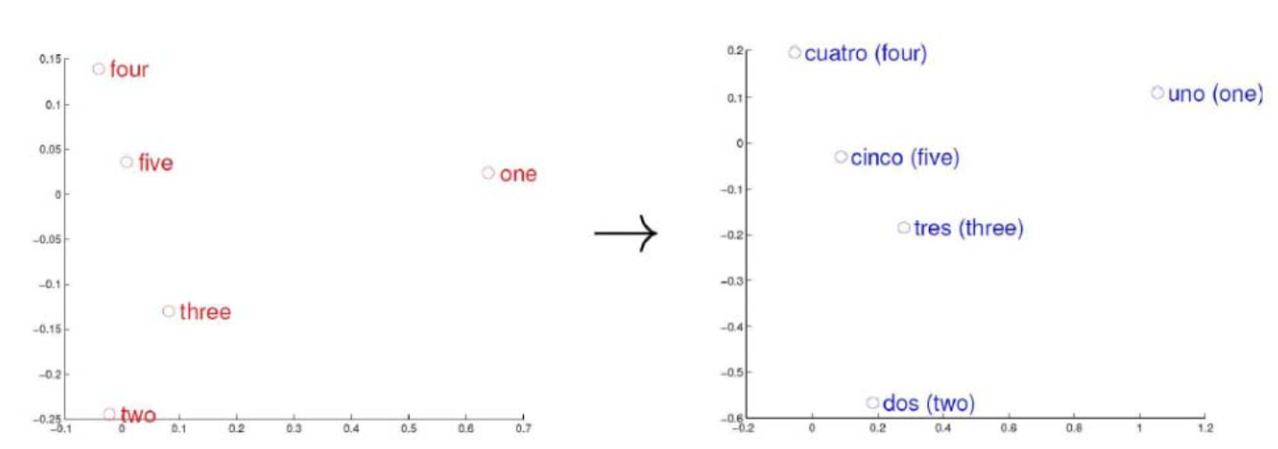
3.3 Explain of Word of Vector
One Hot Representation
N-dimension
Distributed Representation
Project word to a Vector Space
No relation between dimension
Reduce the dimension of samples
Distance determine the similarity
Non-zero number decrease
Common Methods
LSA(Latent Semantic Analysis)
LDA(Latent Dirichlet Allocation)
Word Representation in Vector Space
Word Vector Space in Different Language has Similarity in Structure.

Slide 16
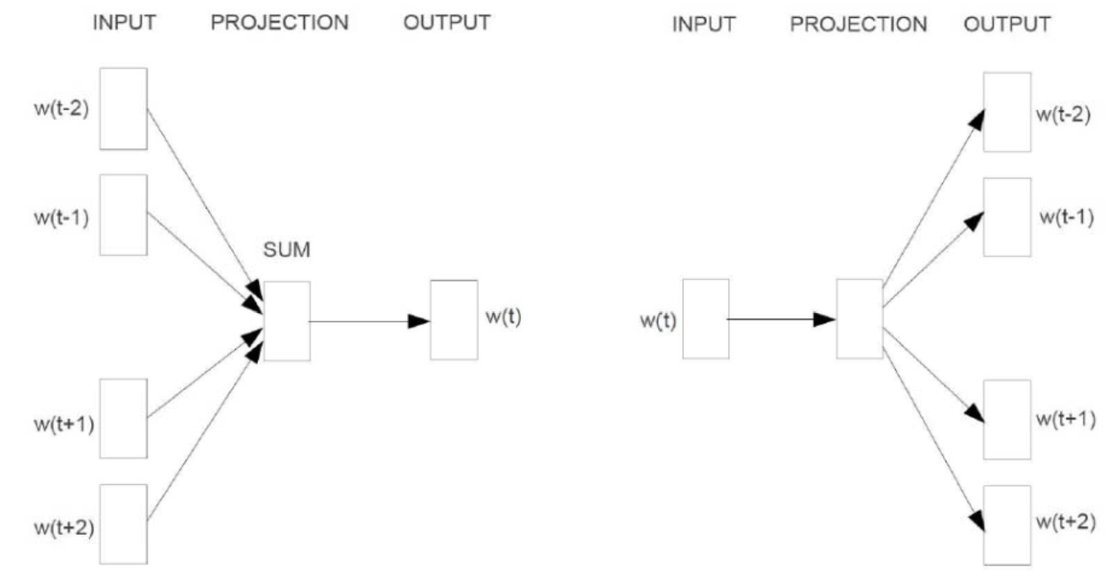
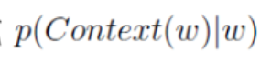
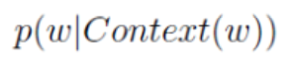
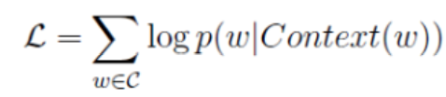
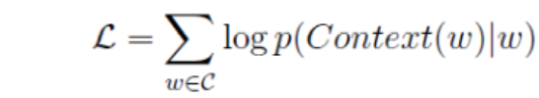
3.4 CBOW and Skip-Gram Model
Construction

Slide 17
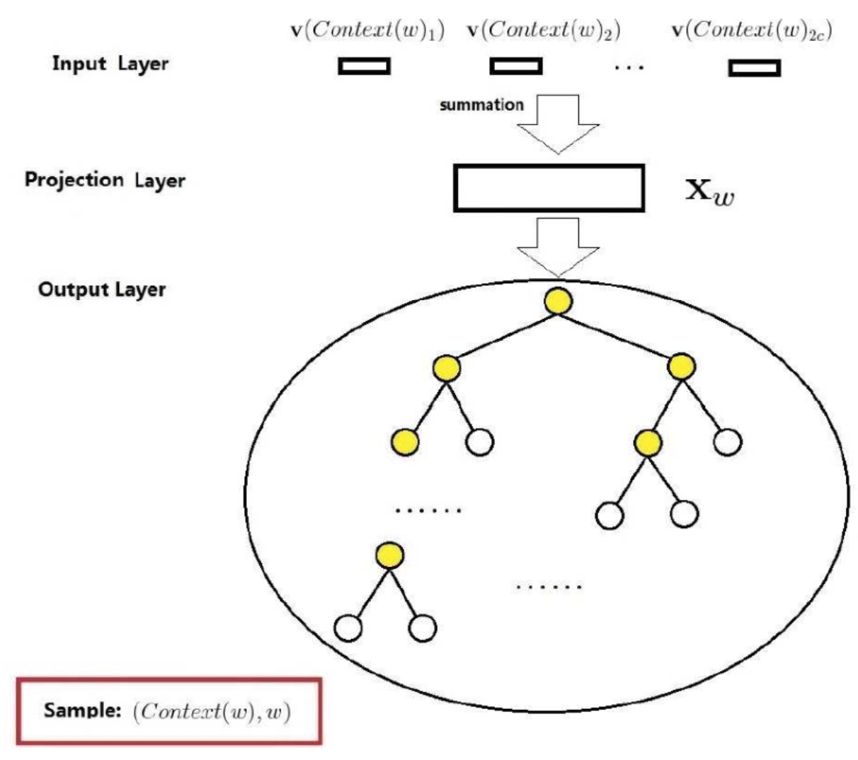




3.5 CBOW based Hierarchical Softmax Model
: path from root to leaf
$l_{w}$ : No. of nodes in $p_{w}$
$p_{1}^{w},p_{2}^{w},…,p_{l_{w}}^{w}$ : $node in p_{w}$, $p_{1}^{w}$ is root, $p_{l_{w}}^{w}$ is node of word w.
$d_{2}^{w}$, $d_{3}^{w}$,…, $d_{l_{w}}^{w}$ : Huffman code of word, $l_{w}$ byte.
$θ_{1}^{w}$, $θ_{2}^{w}$,…, $θ_{l_{w}−1}^{w}∈ R^{m}$ : Vector Corresponding to Non-leaf node in path $p_{w}$
$$x_{w}=\sum_{i=1}^{2c}{v\left({\text{Context}\left(w\right)}_{i}\right) }$$
Differences
Project Layer
Hidden Layer
Output(Linear/Tree)
Leaf is Word(N=|D|)
Non-leaf Node (N-1)
1. $p_{w}➔l_{w}$=5; Node: $p_{1}^{w},p_{2}^{w}$, $p_{3}^{w},p_{4}^{w}$, $p_{5}^{w}$
2. {$d_{2}^{w}$, $d_{3}^{w}$, $d_{4}^{w}$, $d_{5}^{w}$} = {1, 0, 0, 1}(Huffman Coding)
3. $θ_{1}^{w}$, $θ_{2}^{w}$, $θ_{3}^{w}$, $θ_{4}^{w}$ represent the non-leaf node in $p_{w}$
Notes:
此处为什么是输入的累加呢？有什么考量在里边么？$θ_{1}^{w}是中间$向量，只是算法中的辅助向量，理论上我们最后仅仅求得每个word对应的向量即可。
在数中。可以视为每一个节点都是一个二分类task。

Slide 18











3.5 CBOW based Hierarchical Softmax Model
Notes:
此处为什么是输入的累加呢？有什么考量在里边么？$θ_{1}^{w}是中间$向量，只是算法中的辅助向量，理论上我们最后仅仅求得每个word对应的向量即可。
在数中。可以视为每一个节点都是一个二分类task。
参数为θ，此时非叶子节点的向量就可以作为参数θ的角色。
对于v(u)的累积更新，为什么不用|Context(w)|整除呢？

Slide 19










3.6 Skip-Gram based Hierarchical Softmax Model

Slide 20




3.7 CBOW based Negative Sampling Model
Negative Saßmpling
$$Context\left(w\right)➔NEG\left(w\right)≠∅➔L^{w}\left(\tilde{w}\right)=\left\{\begin{aligned}1,\tilde{w}=w \\ 0,\tilde{w} ≠w\end{aligned}\right.$$
$$➔p\left(u|Context\left(w\right)\right)=\left\{\begin{aligned}σ\left(x_{w}^{T}θ^{u}\right),L^{w}\left(u\right)=1 \\ 1−σ\left(x_{w}^{T}θ^{u}\right),L^{w}\left(u\right)=0\end{aligned}\right.$$
$$➔p\left(u|Context\left(w\right)\right)={σ\left(x_{w}^{T}θ^{u}\right)}^{L^{w}\left(u\right)}∗{\left[1−σ\left(x_{w}^{T}θ^{u}\right)\right]}^{1−L^{w}\left(u\right)}$$

Slide 21







3.7 CBOW based Negative Sampling Model

Slide 22








3.8 Skip-Gram based Negative Sampling Model

Slide 23
Tricks
4

Slide 24
4.1 Sampling Functions

Slide 25
2.5 N-Gram Model

Slide 26
Item2Vec
5

Slide 27
2.5 N-Gram Model

Slide 28
2.5 N-Gram Model

Slide 29
Conclusions
6

Slide 30
2.5 N-Gram Model

Slide 31
2.5 N-Gram Model

Slide 32
数据预处理
 | 训练集用户缺失比例 | 测试集用户缺失比例 | 训练缺失/预测缺失
用户基本信息 | ~0% | ~0% | ——
流水记录 | 83.3% | 94.9% | 87.7%
浏览行为 | 14.7% | 13.7% | 107.2%
信用卡账单记录 | 4.4% | 1.8% | 244.4%

Slide 33





模型融合
模型获取
对于未去重的特征数据，训练得模型XGBoost_A、LightGBM
对于去重的特征数据，训练得模型GBoost_B
XGBoost
A
LightGBM
直接加权融合
最终线上KS 0.46703 = 0.05 * XGB_A + 0.20 * LGB + 0.75 * XGB_B
模型融合
Rank融合
$Score= \sum_{i=1}^{n}{\frac{w_{i}}{{rank}_{i}}}$
最终线上KS 0.45238
XGBoost
B

Slide 34
总结
6

Slide 35
总结
融360用户风险预测
精准营销 避免随机投放给用户带来的干扰，提升用户体验
ABC
个人能力的提升与团队协作的锻炼
Notes:
接近工业实际的比赛环境，是我们能够综合考虑资源消耗和算法稳定性、精确度等问题，最终取得了良好的效果，在1505支队伍中取得冠军。最后，我们团队的每个人都从这个比赛中学习到了很多，这道题目不仅锻炼了我们的个人能力，培养了我们用工业实际的角度来考虑问题的角度，也锻炼了我们团队协作的能力。在此我们像比赛的组织方和项目的出题方致以崇高的敬意和真挚的感谢。

Slide 36
THANKS
请各位专家批评指导！
Notes:
以上就是我此次报告的内容，谢谢大家~

